Slide 1
National Policy Dialogue on water policy in Moldova Updating Strategy and Action Plan for WSS in Moldova
European Union Water Initiative plus for Eastern Partnership
Alexander PoghosSIan, Alpha Plus Consulting
Chisinau, JUNE 15, 2018

Slide 2
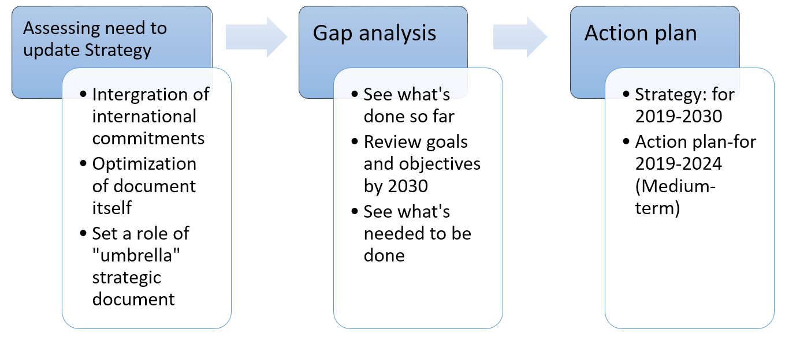
Project overview
Plus PFM component

Slide 3
Assessing need to update strategy
Integration of international commitments
SDG 6 (clean water and sanitation) commitments (Priority 10 in M2030)
Protocol on Water and Health (NP 16-25)
EU-Moldova Association agreement
Directives:
Directive 91.271.EEC urban waste water treatment
Directive 98.83.EC on quality of water for human consumption
Directive 2000.60.EC establishing framework for Community action in water policy
Espoo Convention
Bilateral conventions with Romania and Ukraine
Others
Harmonization
Timing (from S.14-28 to S.19-30/AP.19-24), 2030 being target year for all key docs
Terminology
Actions
Notes:
National legislation
Law on Water 272 (changes in process)
Environmental Strategy for 2014-2023 and its action plan (April 2014)
River Basin Management Plans for the rivers Prut and Nistru
Regionalisation

Slide 4
Bringing in key policy adjustments
Master Plan (country-level inventory-taking and mapping of WSS infrastructure needs)
Efficient donor and development partner coordination of efforts
Wastewater sludge treatment
Mandatory subscription of users to any (centralized or local) water supply and wastewater removal systems (critical for investment decisions)
Realistic terms for EU directives fulfilment
Notes:
National Plan for Planning the Territory (obsolete), code of urbanism and construction. Documents are the same, calling them differently. Land development plan. Master plan is a part of Plan of Urbanism. National Spatial Plan. Also called WSSP
Defining the obligations and responsibilities between each institution involved in the investment planning process and creating mechanisms for ensuring communication and interaction between all the stakeholders;
• Prioritizing the investments in water and sanitation infrastructure based on a detailed analysis of the situation, and of technical and institutional options;
• Developing a short, medium, and long-term phased investment plan for urban and rural water and sanitation infrastructure.

Slide 5
Done so far
Review of WSS strategy
Review of status and process of development of other key documents
Stakeholder interviews
Review of action plan status and progress

Slide 6
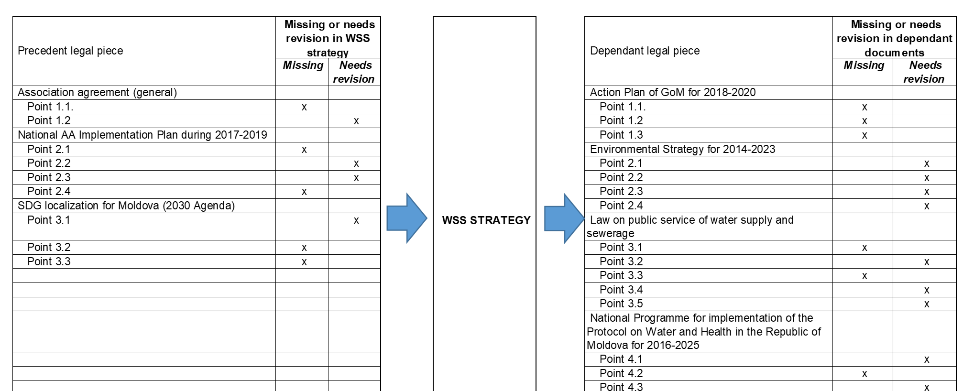
GAP Analysis

Slide 7
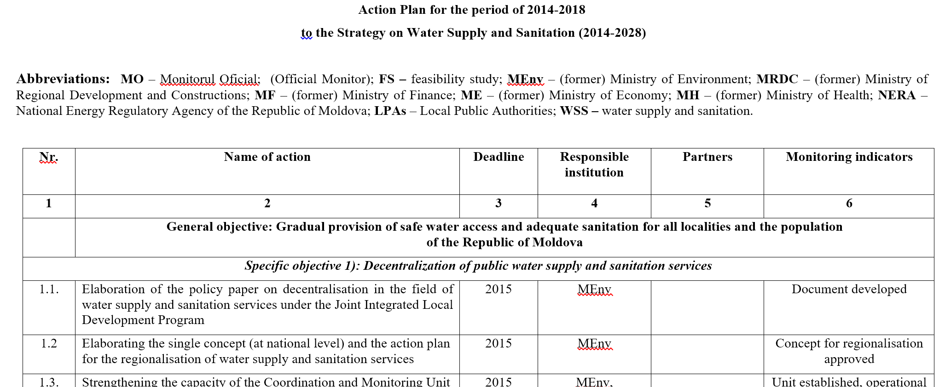
Action plan

Slide 8
Action Plan logical flow-chart
OLD ACTION PLAN
O.A.P. SANITIZED
FILTERING ON
EXECUTION AND IMPORTANCE
NEW ACTION PLAN
POLICY ADJUSTMENTS (conversion from Str. to AP)
PRIORITIZATION and PLAUSIBILITY REVIEW
NEW (ongoing and upcoming) PLANS/INITIATIVES

Slide 9
As a result we will have
“Umbrella” strategic document for stakeholders (government agencies, development partners, investors etc.) to refer to and use a guide for specific complementary (rather than duplicating) engagements
Proposal to shift deadlines for compliance with WSS related EU Directives to have a more realistic set of deadlines
Action plan with prioritized and realistically assessed measures (can partly repeat/overlap or serve as a guide for other action plans, but NOT CONFLICT with them)

Slide 10
PFM Component
NOT solely about budget allocations to the WSS sector, BUT budget decision makers (Executive and Legislature) must receive evidence on WSS expenditure effectiveness and their direct linkage to SDG targets and other international commitments of Moldova
WSS policy must be adequately and effectively reflected in various elements of the budget cycle
Address common gaps between budget processes and WSS policy documents Gap exists in many sectors and in many countries at various scale and it is not a unique problem for Moldova.

Slide 11
PFM Component
GOALS
to assist in integrating WSS related policy in the budget cycle
to improve informed decision-making on WSS related public finance

Slide 12
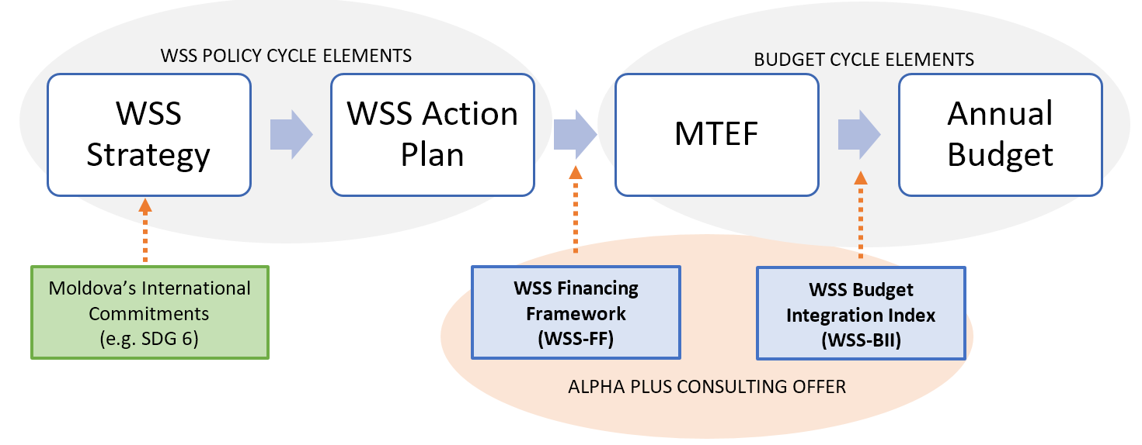
Enhancing Integration of WSS Strategy with National Budget

Slide 13
WSS Budget Integration Index Tool in Moldova
Systemic approach and objective validation of the progress towards WSS integrated PFM system in countries
Setting a baseline, prioritization and helping with formulation of a reforms agenda for WSS integration (guidance for formulating the country’s reforms directions and agenda)
Allows a cross-country comparison, especially relevant in the regional context
Platform for cooperation framework with development partners – extremely relevant and important in the case of Moldova

Slide 14
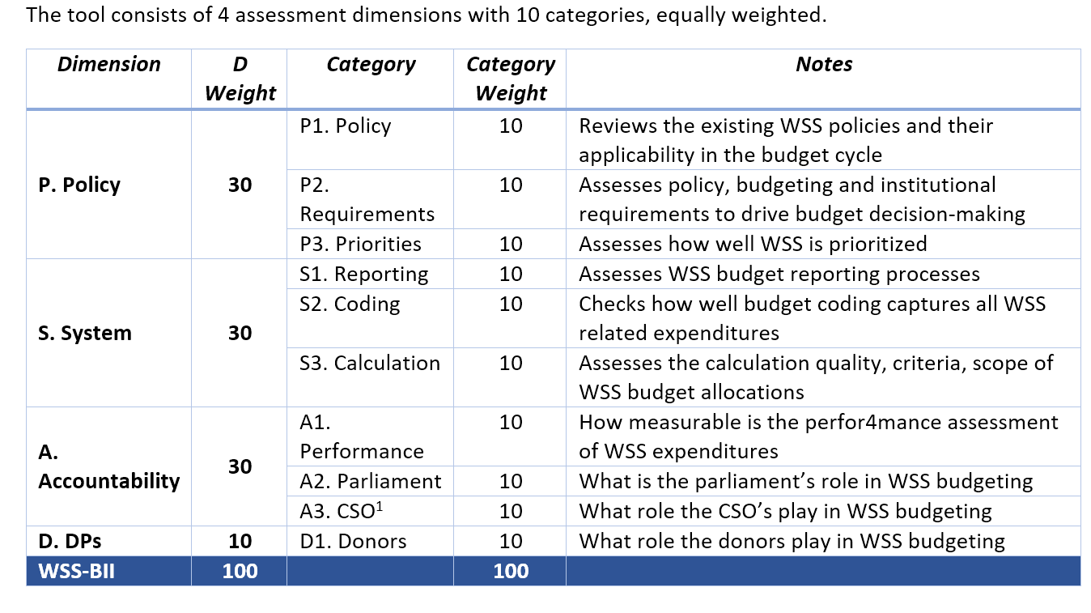
SDG 6 Budget Integration Index Tool in Moldova

Slide 15
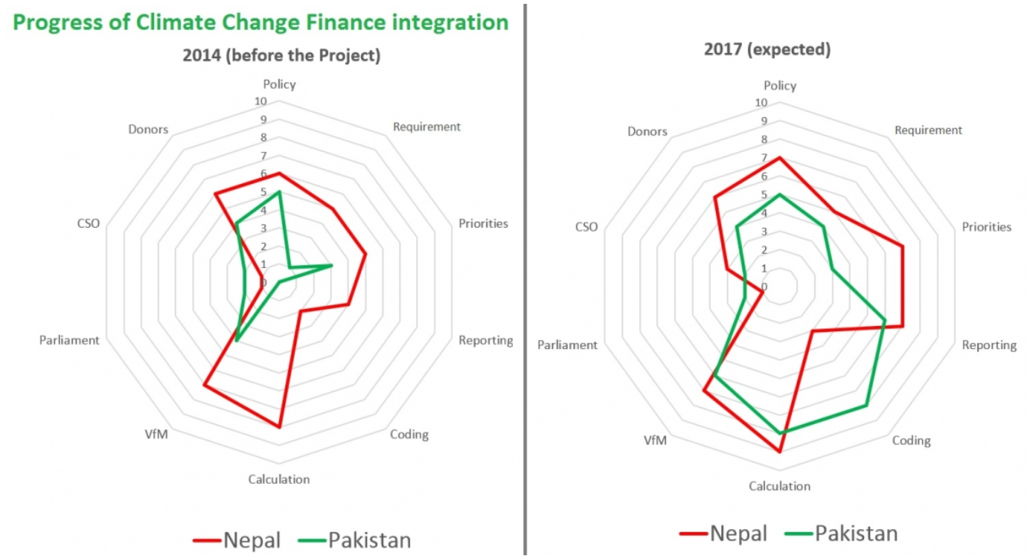
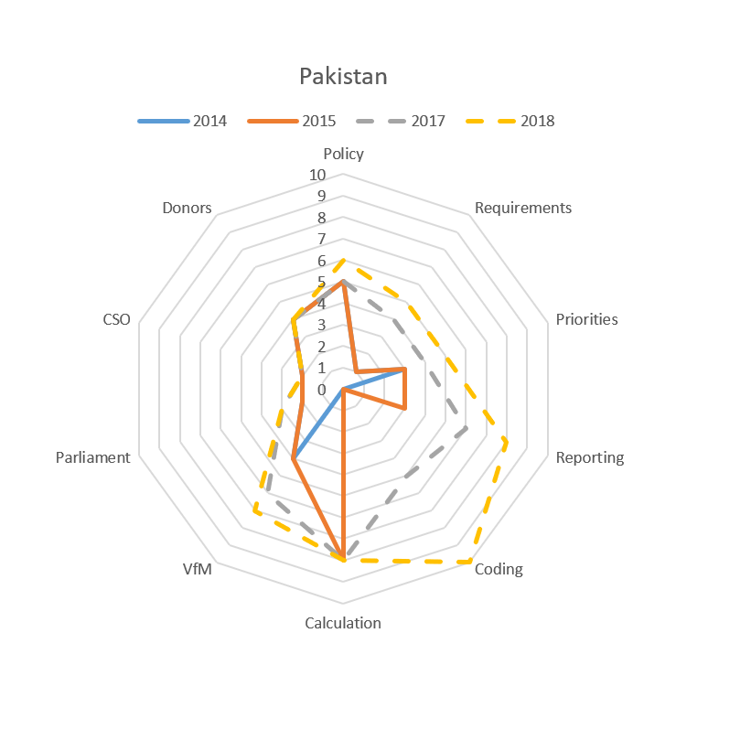
SDG 6 Budget Integration Index Tool: benefits for countries

Slide 16
Introducing and Institutionalizing WSS Financing Framework
The Goal of the WSSFF is to better inform the MTEF process and consequently the budget decisions by providing comprehensive picture on:
i) financing needs of the sector over the strategic period (demand for resources to fully execute the plan)
ii) existing commitments (committed resources often based on historical financing patterns, signed loan or grant agreements and current forecast on supply of existing resources, including household and private sector)
iii) variance (financing gap) – not only numerical value, but also prioritization and scenario filling in thereof

Slide 17
European Union Water Initiative plus for Eastern Partnership
THANK YOU

