Slide 1
Groundwater

Slide 2
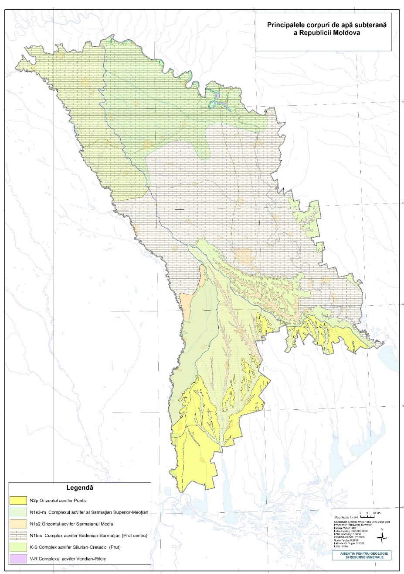
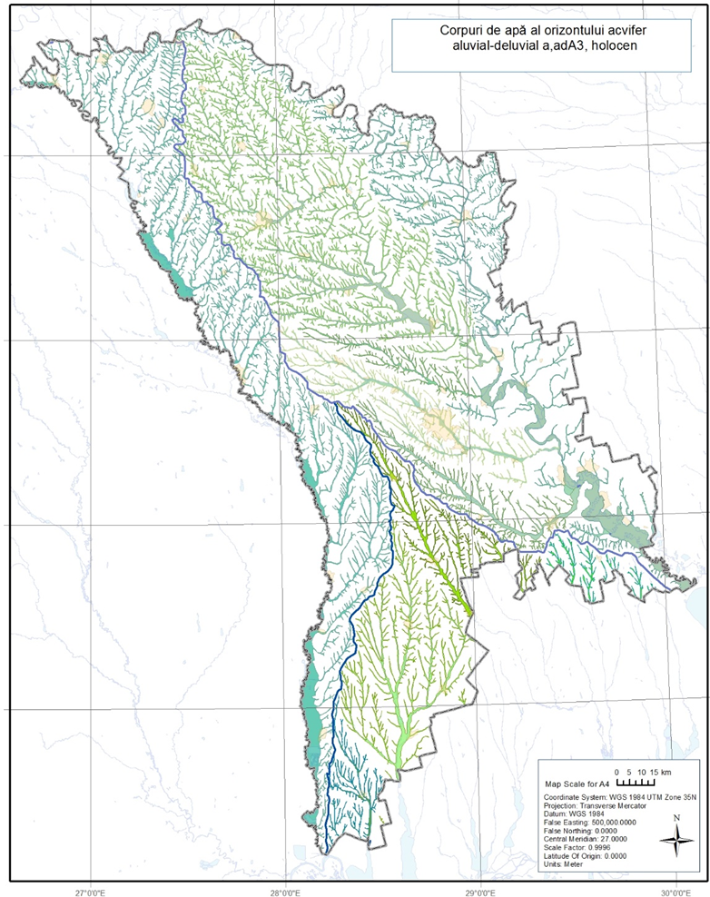
Groundwater bodies in Moldova
Name of the aquifer | Water bearing sediments | Number of identified GWB
Holocene alluvial aquifers in Prut river valley and all its terraces (aA₃) | Sand, gravel, sandy loams | 3
Pliocen-Pleistocen alluvial aquifers | Sand, gravel, sandy loams | 2
Badenian- Sarmatian aquifer system ( N₁b+s₁) | Limestone with interlayers of fine grained sand sometimes clays and marls | 5
Upper Sarmatian Meotic aquifer system (N₁S₃+m) | Fine grained sands in a form of disconnected lenses | 3
Middle Sarmatian (Congeriev) aquifer ( N₁S₂) | Fine grained sands with interlayers of clays, sandstones and limestones | 3
Upper Neocene Pontian aquifer (N_{2p}) | Sandy clays with interlayers of sand and shell limestone | 2
Silurian-Cretaceous aquifer system (S₂-K₂) | Limestone, sandstone, with interlayers of Silurian marls and argillites | 2
Vendian-Refian aquifer system | Sandstone | 1
Total: |  | 21

Slide 3
OBJECTIVES OF GROUNDWATER MONITORING
CIS Guidance Document No. 7 “Monitoring under the Water Framework Directive” advises to design groundwater monitoring programmes based on a conceptual understanding of the groundwater system and impact of pressures on this system
Results of groundwater monitoring programmes are used for:
Assessment of quantitative and chemical status of all groundwater bodies or groups of bodies;
Estimating groundwater flow direction and flow rate in transboundary bodies;
Assessment of long term trends in pollutant concentrations caused by both natural and anthropogenic factors;
Determining the chemical status of groundwater bodies that are at risk of failing to meet WFD environmental objectives;
Detecting upward trends in pollutant concentrations due to either natural or human impacted causes or defining starting points for trend reversal. Reducing trends in pollutant concentrations may be caused by the applied measures, increasing trends may also indicate on potential new threats to groundwater status from other human induced pressures;
Assisting design and evaluating the effectiveness of programmes of measures;
Demonstrating compliance with drinking water protection areas (DWPA) and other protected area objectives, e.g. Natura2000, Habitats and Birds directives, etc.

Slide 4
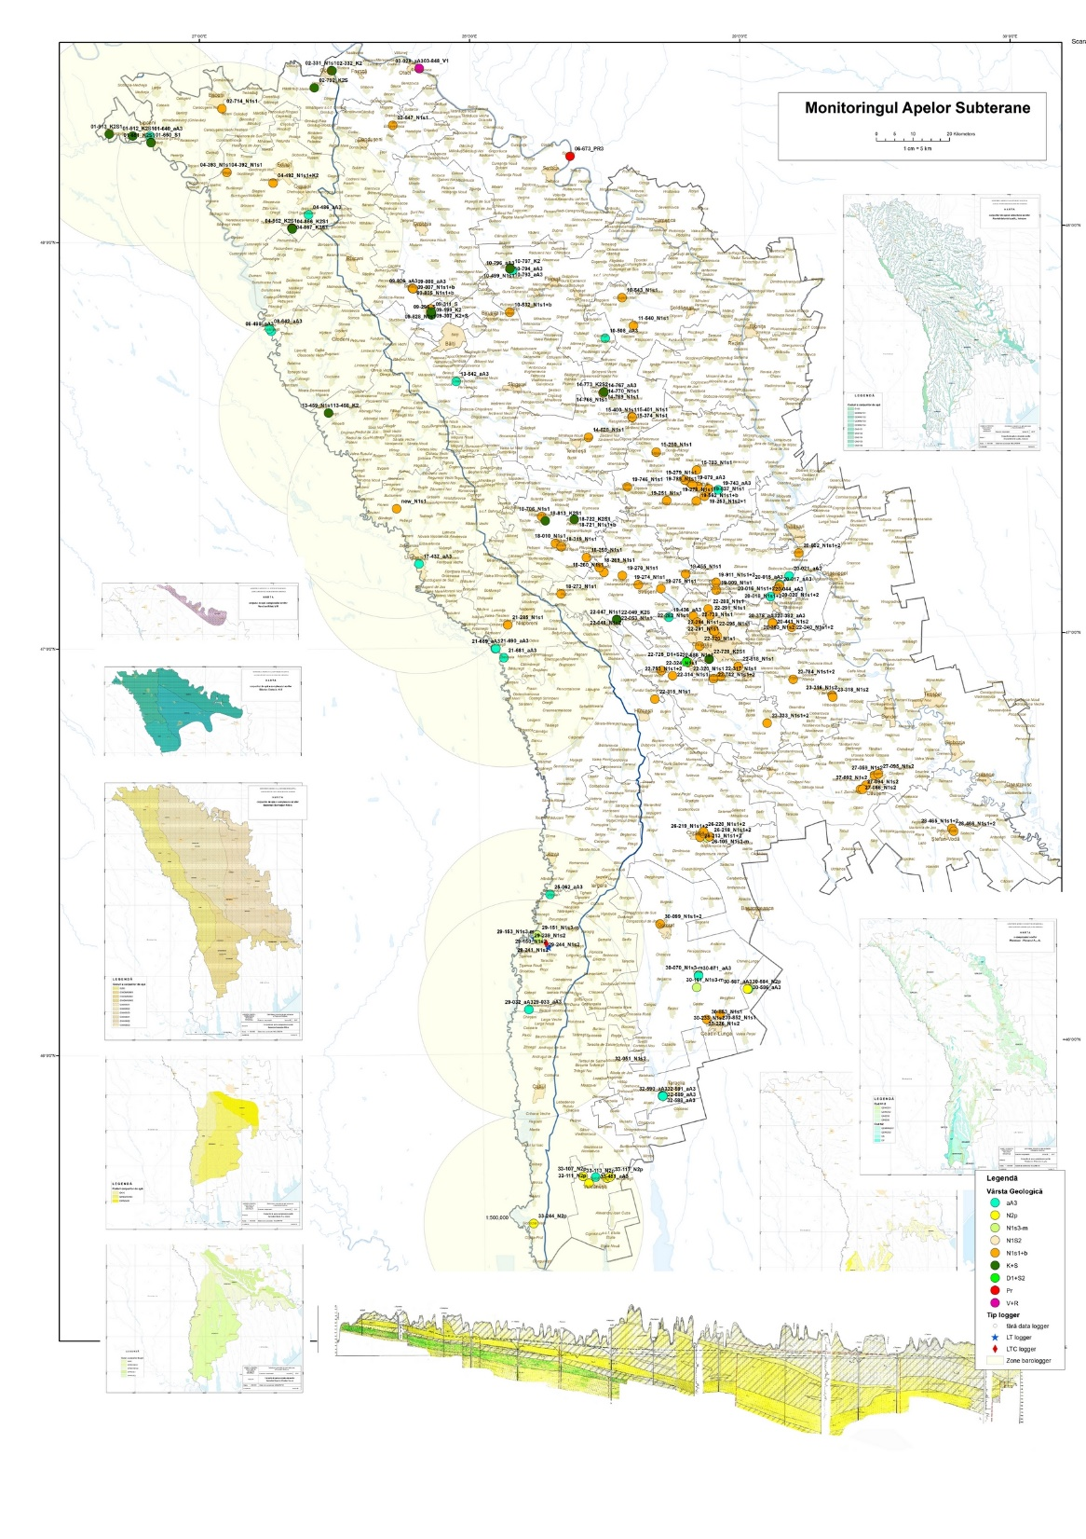
GROUNDWATER MONITORING
National groundwater monitoring network in the Moldova consists of 175 monitoring stations installed into unconfined and artesian aquifers and is used for the routine observations of quantity and quality of impacted by abstraction underground aquifers:
Alluvial (aA₃)
Pontian (N₂p)
Upper Sarmatian-Meotic (N₁s₃-m)
Middle Sarmatian (Congeriev), (N₁s₂)
Badenian-Sarmatian (N₁s₁-b
Silurian-Cretaceous (K₂-S₁)
Vendian (V)

Slide 5
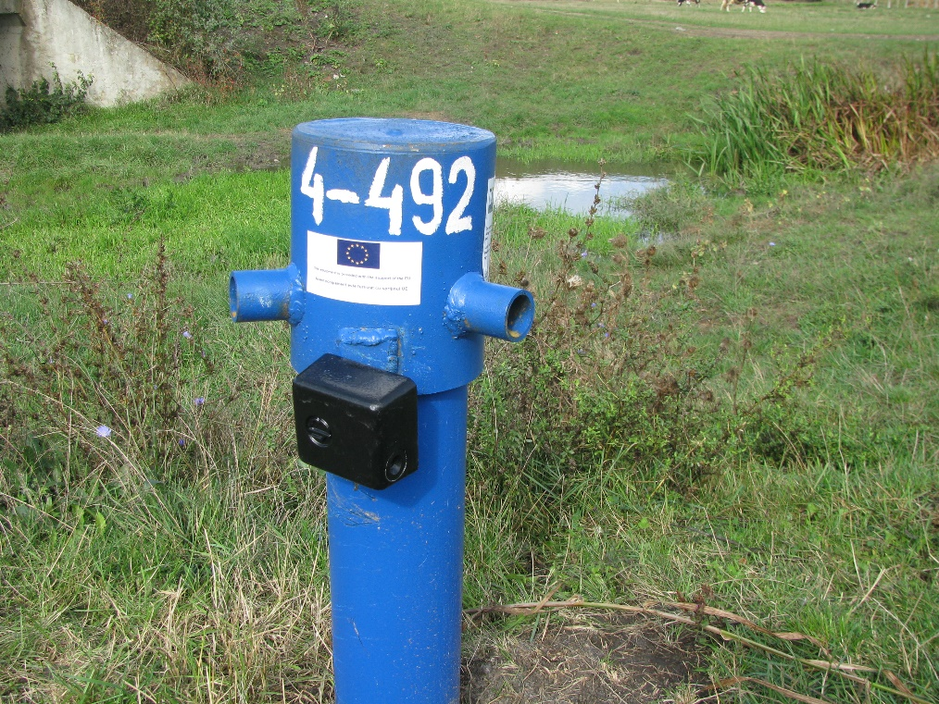
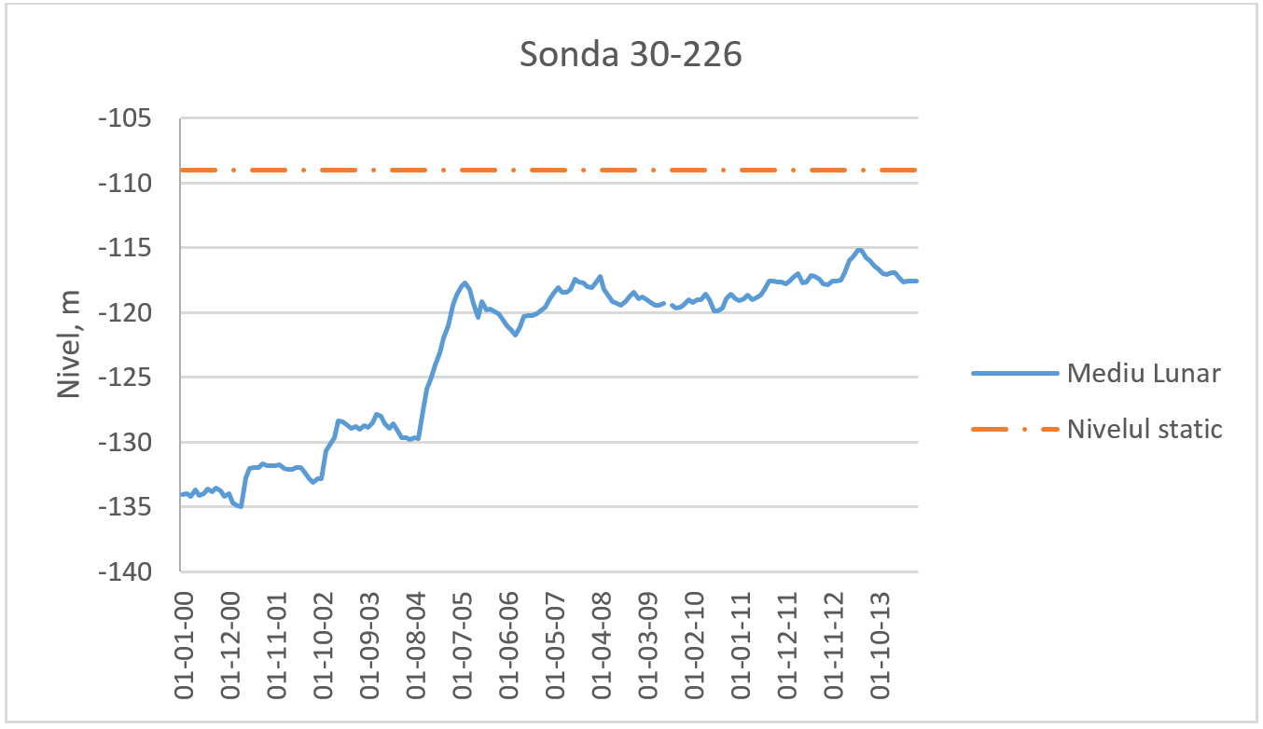
Government Decision No. 932 of November 20, 2013 approved the Regulation on monitoring and systematic observation of the state of surface and groundwater.
In accordance with this Decision, the Agency for Geology and Mineral Resources is responsible for monitoring the quality and quantity of groundwater in the territory of the Republic of Moldova.
The following types of work are performed:
Studying the regime of groundwater.
Studying the chemical composition of groundwater.

