Slide 1
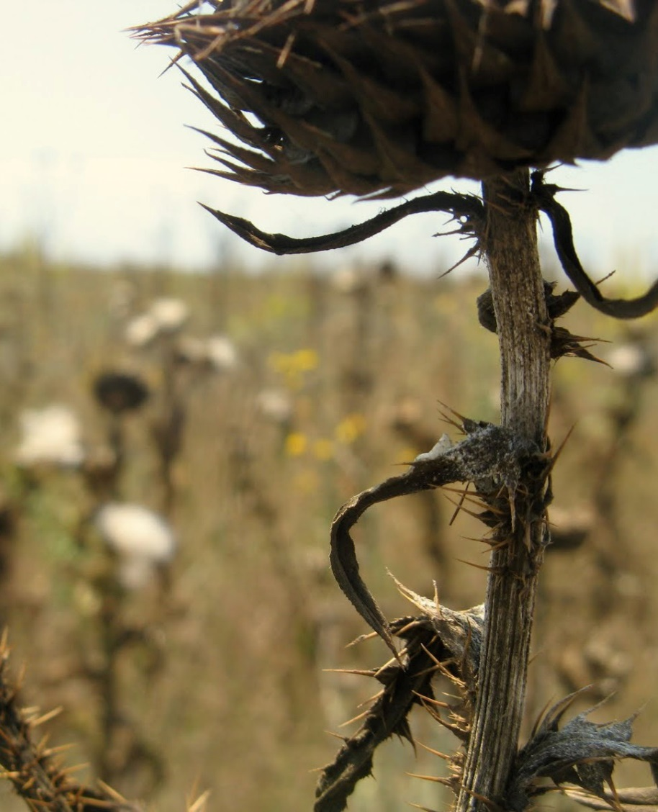
Integrated Drought Management Programme in Central and Eastern Europe
The fourth meeting of the Coordination Committee
of the National Policy Dialogue on IWRM in the Republic of Moldova
Dumitru Drumea, GWP Moldova

Slide 2



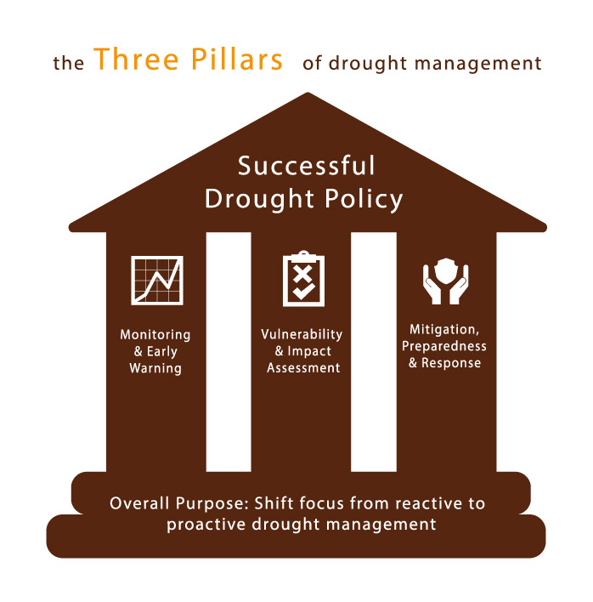

Managing Water Extremes
WMO/GWP Associated Programme on Flood Management (APFM) – established in 2001
WMO/GWP Integrated Drought Management Programme (IDMP) – established in 2013
IDMP in Central and Eastern Europe
1st phase: started in March 2013
2016 – preparation of project proposals and 3-year workplan
2nd Phase: 2017 - 2019

Slide 3
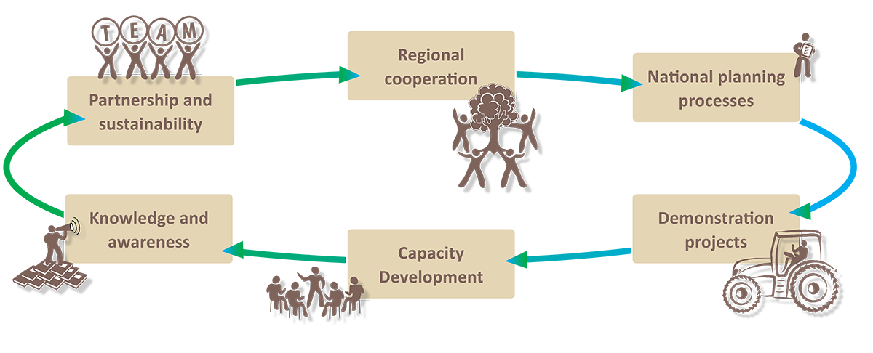
Focus
variability and change in precipitation
increased frequency of extreme weather events in the future
well developed meteorological and hydrological monitoring but not as a support for decision makers
limited sharing of information among countries
lack of political will to solve the problem – drought was not considered as a relevant issue
Increase the capacity of the CEE region to adapt to climatic variability by enhancing resilience to drought.

Slide 4
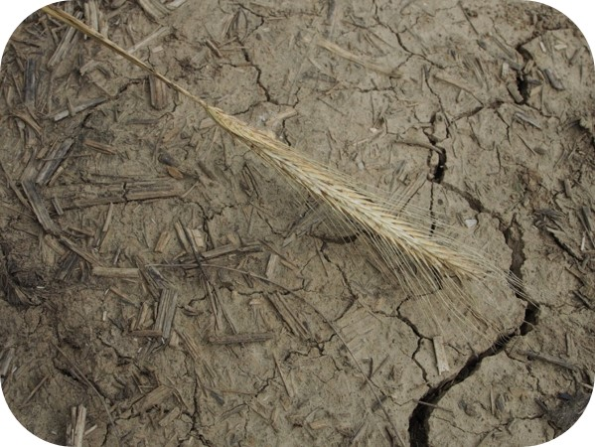
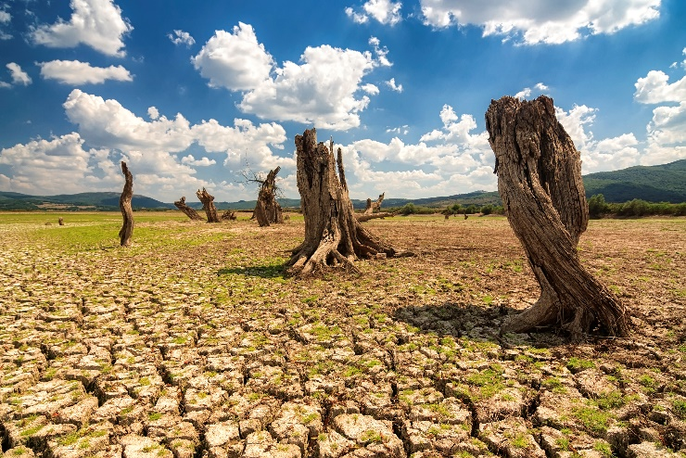
Approach
From reactive to proactive drought management
Knowledge management: best practices in early warning and drought planning management
Guidance on technical and institutional aspects: tools and methodologies to support better drought risk management and response
Advocacy: stakeholder participation in integrated drought management through regional and country dialogues
Capacity building: drought risk awareness raising through vulnerability assessments and risk mapping to develop preventive action against drought

Slide 5
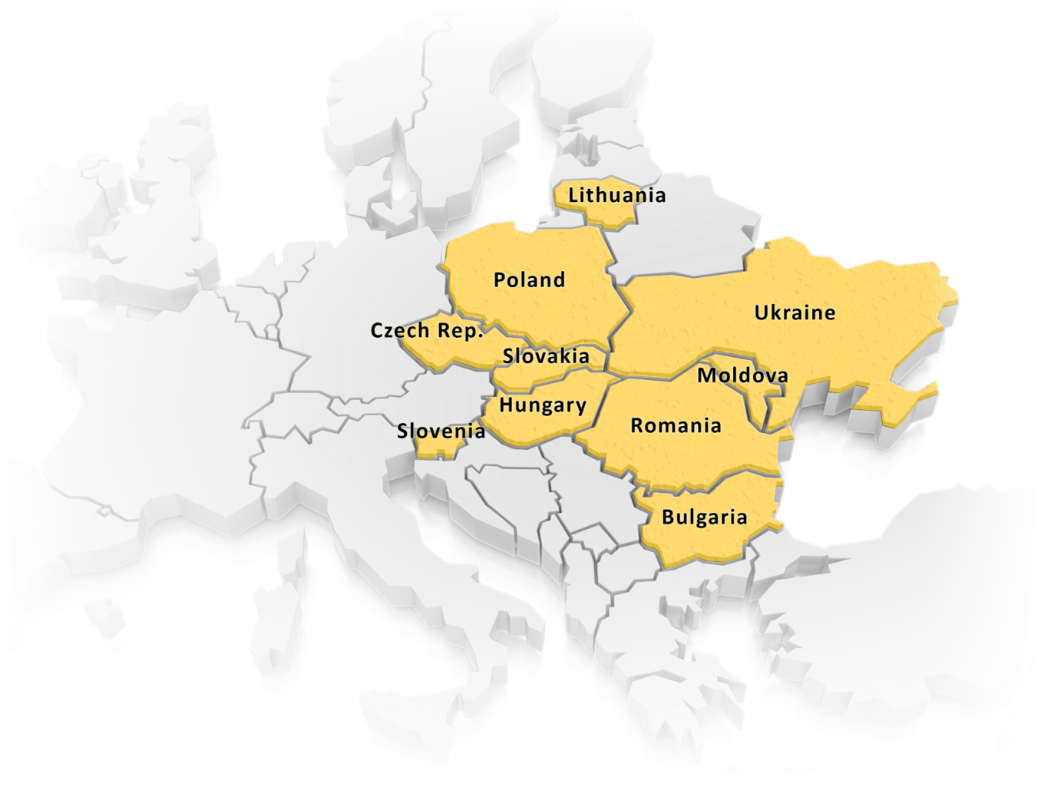
Regional cooperation
Ukrainian Research Institute
of Forest and Forest Melioration (UA)
10 countries & 28 institutions cooperating:
  Drought Management Center for Southeastern Europe
  Universities
  Hydro-meteo services
  Research institutes
  Ministries & state agencies
Vilnius University (LT)
Institute of Agricultural and
Forest Environment (PL)
Institute of Meteorology
and Water Management (PL)
Soil Science and
Conservation
Research Institute (SK)
Research Institute for Soil and Water Conservation (CZ)
Institute of Ecology
and Geography (MD)
Biotechnical Faculty (SLO)
Slovak Hydrometeorological Institute
National Meteorological
Administration (ROM)
Limnos Ltd. (SLO)
National Scientific Center for Global Changes (BG)
Slovenian Forestry Institute
University of Debrecen (HUN)

Slide 6
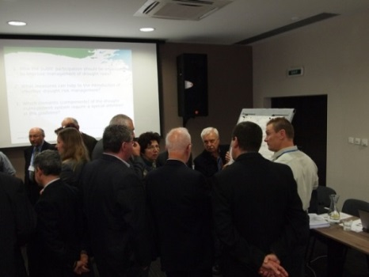
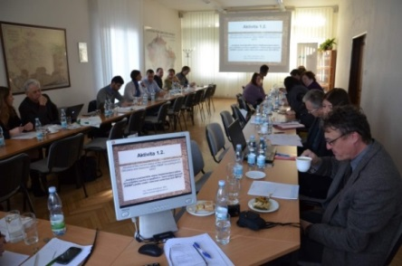
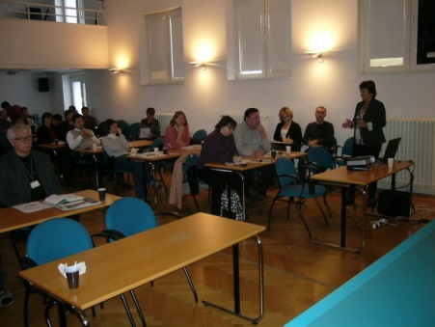
Cooperation with national governments
Main challenges:
  Lack of political will to solve the problem – drought was not considered as a relevant issue.
  Solutions:
  cooperation with national governments to help incorporate drought management issues into national programs, policies and plans
National Consultation Dialogues
1st round – setting the stage
review of the current status
2nd round – how to overcome gaps in the current drought management; developing Guidelines; national experiences and examples
3rd round – action plan/update for preparation of the Drought Management Plan

Slide 7
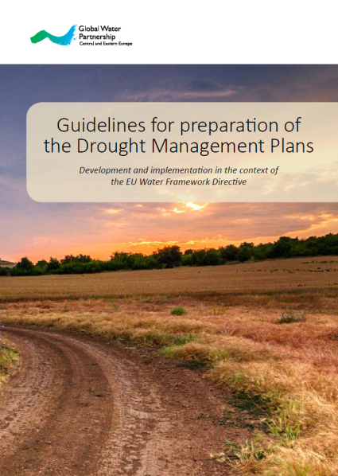
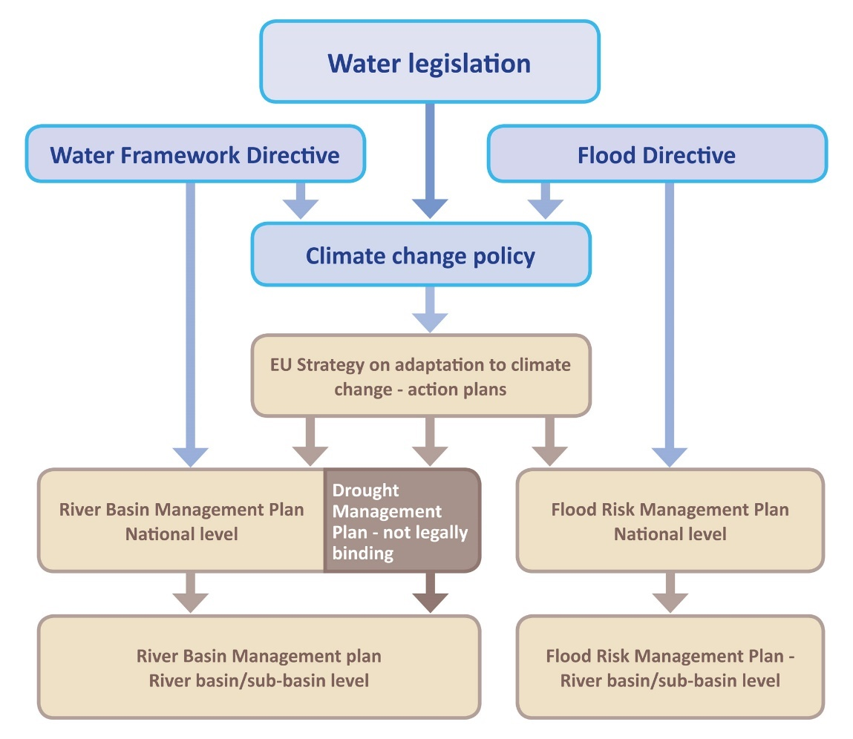
Cooperation with national governments
Main challenges:
  Gaps in the implementation of the EU Water Framework Directive (WFD).
  Solutions:
  Preparation of guidance document
Published in September 2015

Slide 8
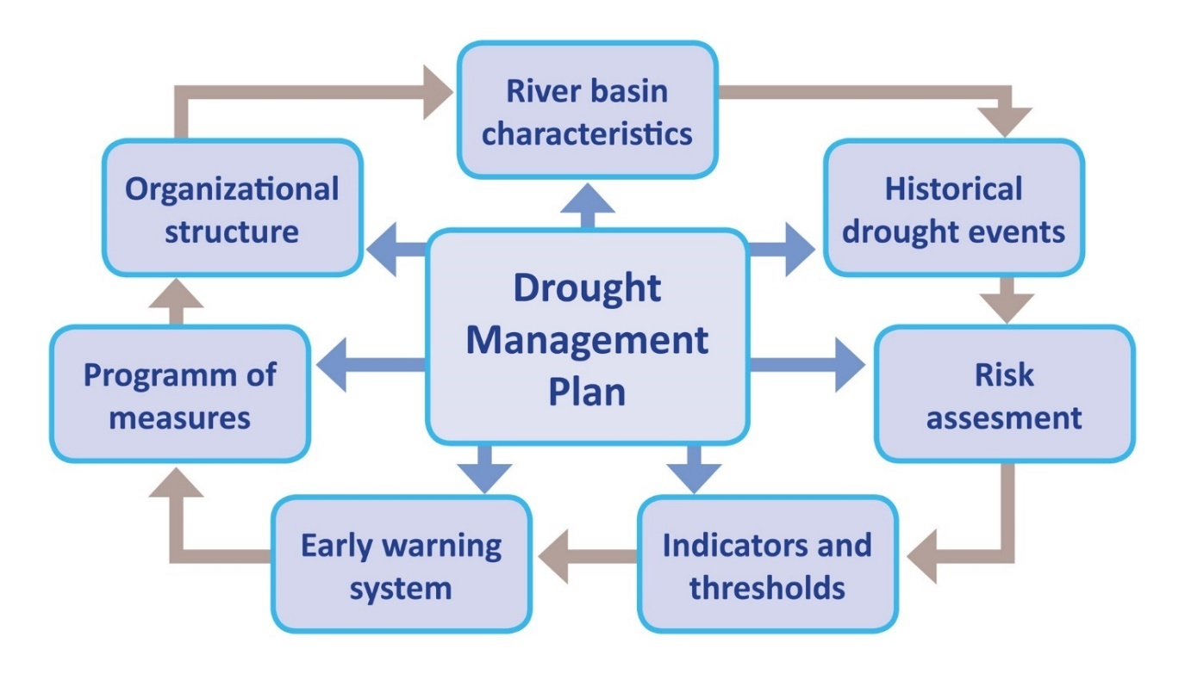
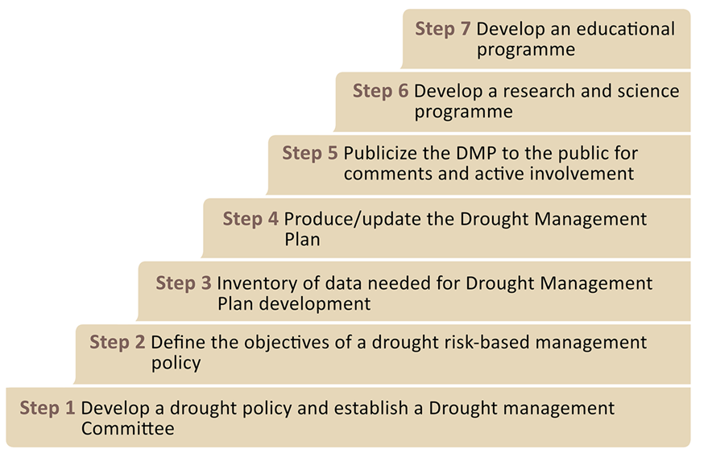
Guidance for preparation of drought Management Plans
7 steps to integrate drought into planning process for development of the RBMPs
Parts of the Drought Management Plan

Slide 9
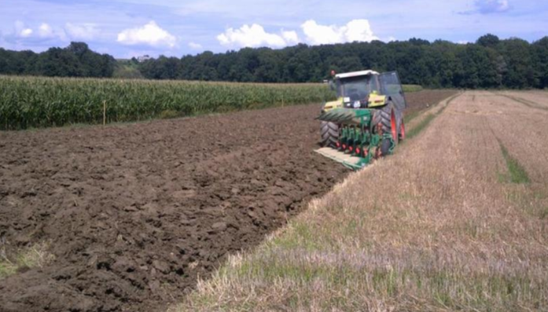
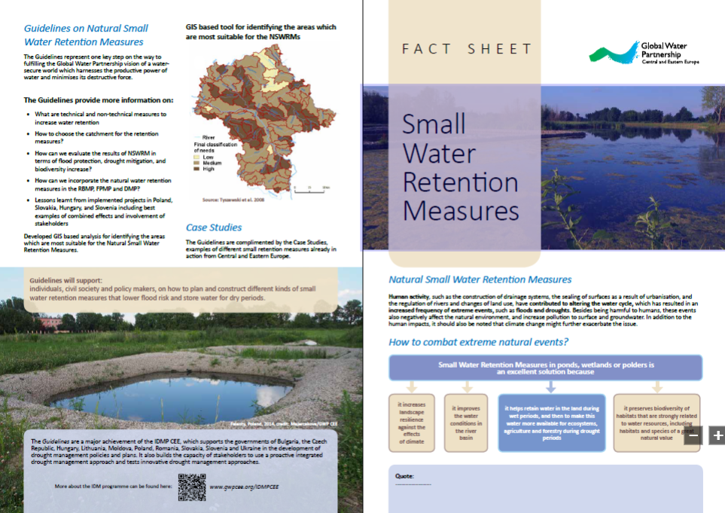
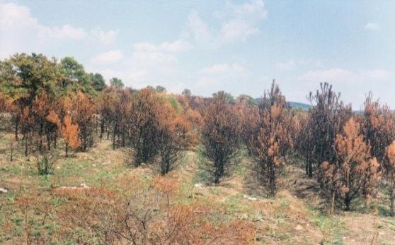
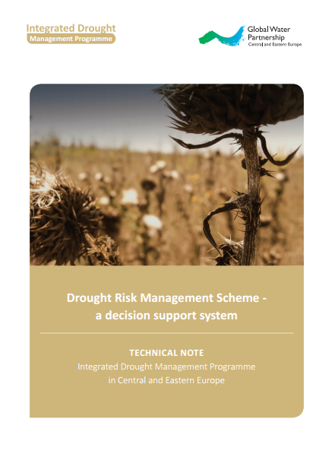
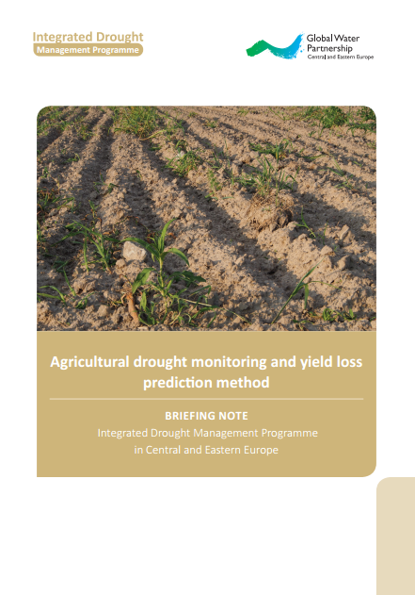
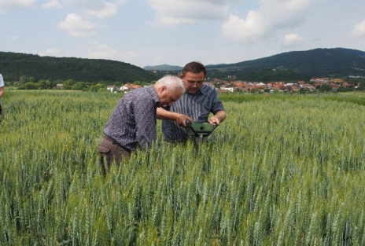
Testing and describing new approaches towards proactive drought management
focusing on agricultural sector as one of the most vulnerable ones in the region
Natural Small Water Retention Measures
Increasing soil water holding capacity
Drought impact on forest ecosystems
Remote sensing agricultural drought monitoring methods
Updating agricultural drought monitoring and forecasting in Ukraine and Moldova

Slide 10
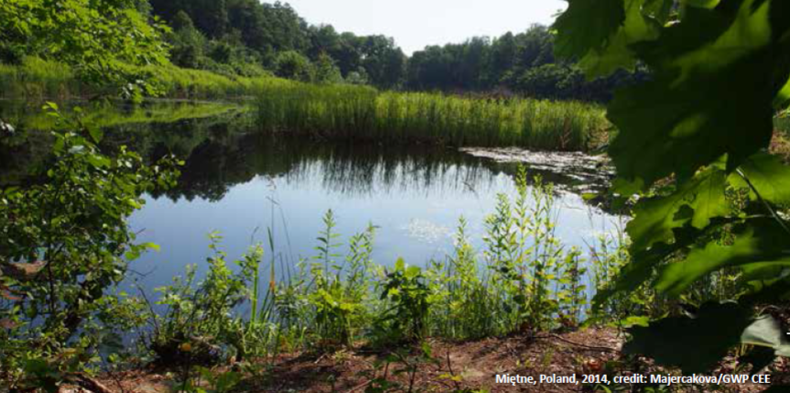
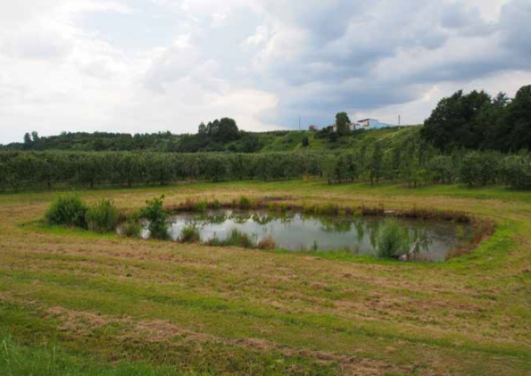
Natural Small Water Retention Measures
adaptive measure which serves to adjust to extreme climate variability
Retain water in the land during wet periods and make this water available for ecosystems, agriculture and forestry during drought periods
&
slows down flood waves during flood periods
improve the water conditions in the river basin
increase landscape resilience against the effects of climate
preserve biodiversity of habitats that are strongly related to water resources, including habitats and species of a great natural value

Slide 11
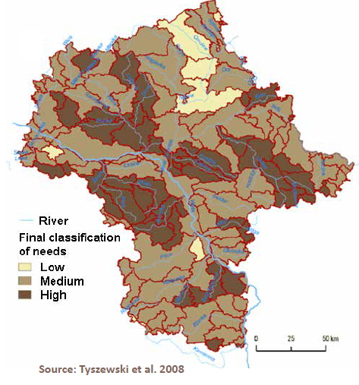
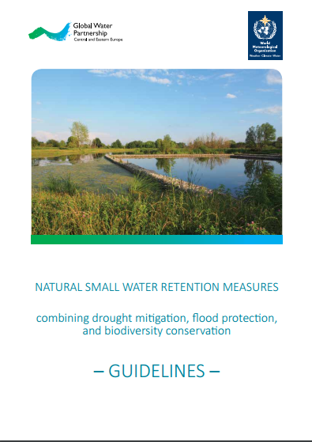
Guidelines on Natural Small Water Retention Measures
What are technical and non-technical measures to increase water retention?
How to choose the catchment for the retention measures?
How can we evaluate the results of NSWRM in terms of flood protection, drought mitigation, and biodiversity increase?
How can we incorporate the natural water retention measures in the RBMP, FPMP and DMP?
GIS based tool for identifying the areas which
are most suitable for the NSWRMs

Slide 12

Follow-up of the Natural Small Water Retention Measures
Framework to improve water balance and nutrient mitigation by applying small water retention measures (FramWat)
to strengthen regional possibilities for floods, droughts and pollution risk reduction by increasing the buffer capacity of the landscape using the N(S)WRM approach in a systematic way.
Topics:
most precise localization of measures (technical and non-technical) in a river basin
assessment of the effectiveness of the system of the measures in the river basin
connection with implementation of the 2nd RBMP and planning of the 3rd RBMP

Slide 13
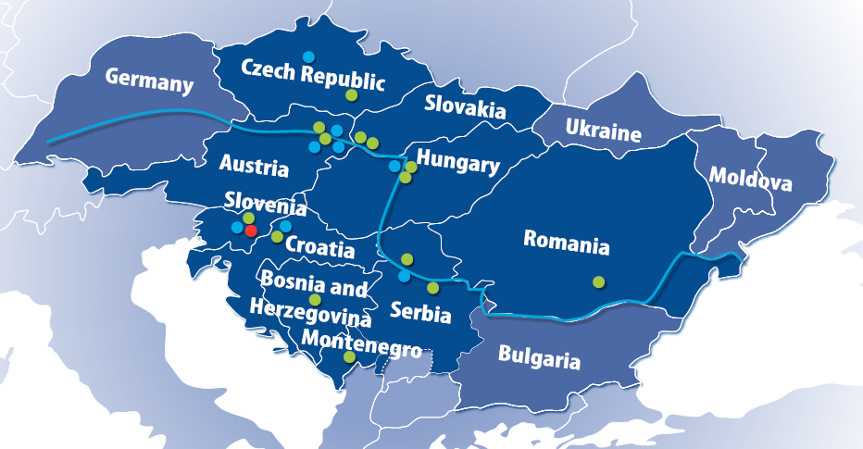
Drought Risk in Danube Region
DriDanube
Project financed by European fund for regional development (85%)
Lead partner: ARSO/DMCSEE
Project budget: 1.974.750,00€
Duration of project: 30 months (January 2017 – June 2019)
Slovenia 2
Austria 2
Czech Republic 1
Slovakia 2
Hungary 2
Romania 1
Croatia 1
Serbia 2
Montenegro 1
Bosnia and Herzegovina 1
7 EU countries
3 Non-EU countries
15 partners
8 Strategic partners

Slide 14
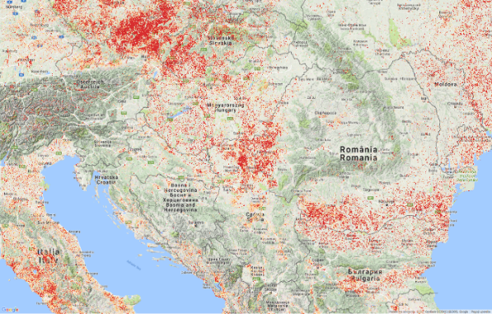
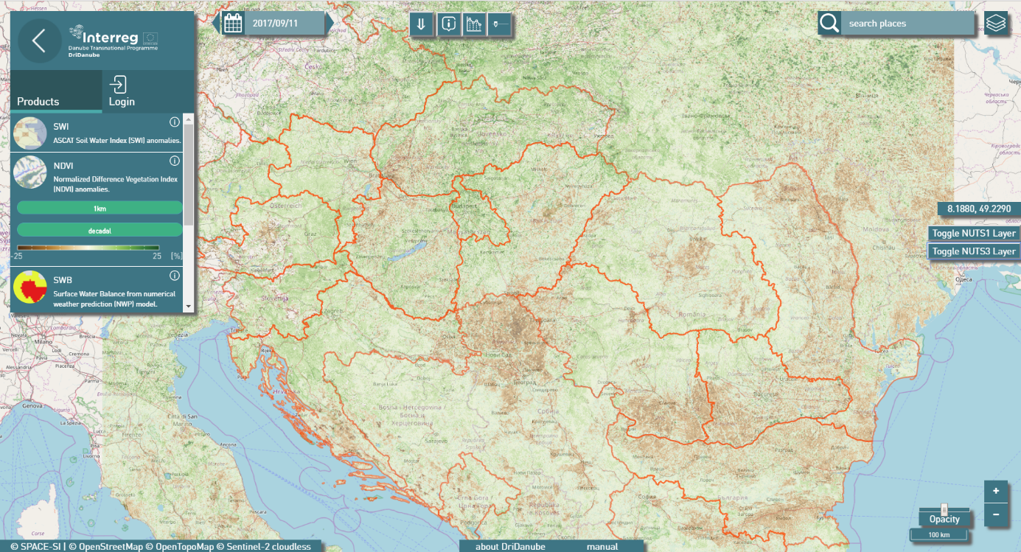
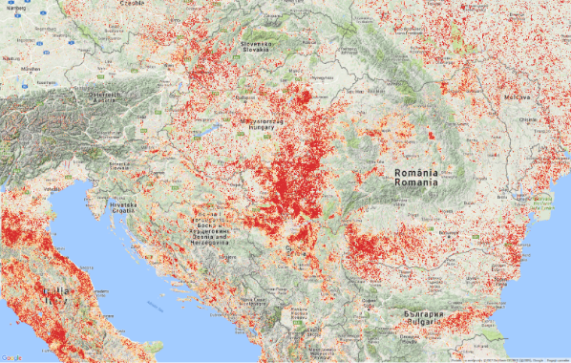
Main Outputs
Drought User Service
User interface, combining remote sensing data from CGLS and drought impact assessment models
NDVI anomaly, 1.7.2017
NDVI anomaly, 1.8.2017

Slide 15
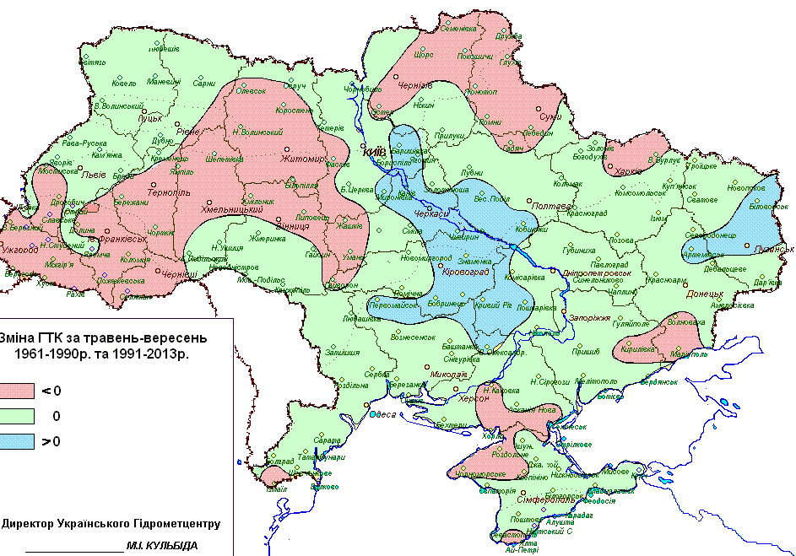
Agricultural drought monitoring and forecasting in Ukraine and Moldova
Upgrade data assessment and forecasting tools to support drought management and monitoring
Upgraded climate-zoning of Ukraine territory and Dniester River Basin territory
Drought risk maps for agro sector of Ukraine and Dniester river basin
Agroclimatic zoning for May- September (1961-2013) according to Selyaninov's hydrothermal coefficients

Slide 16
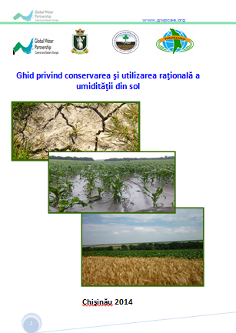
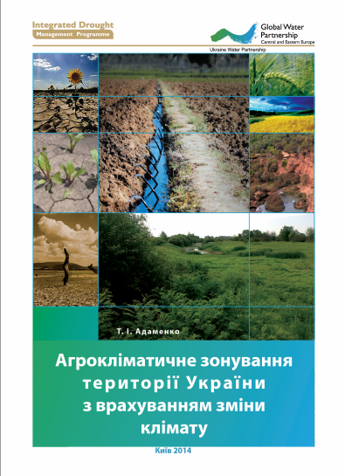
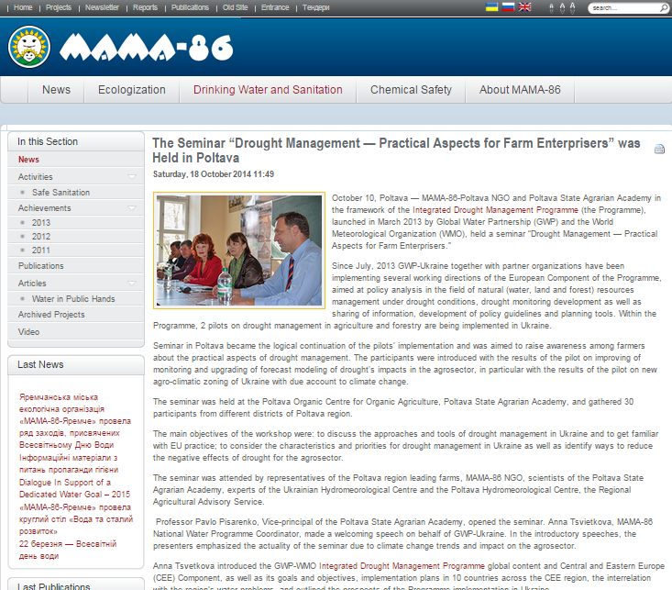
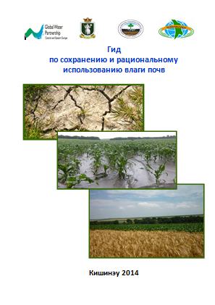
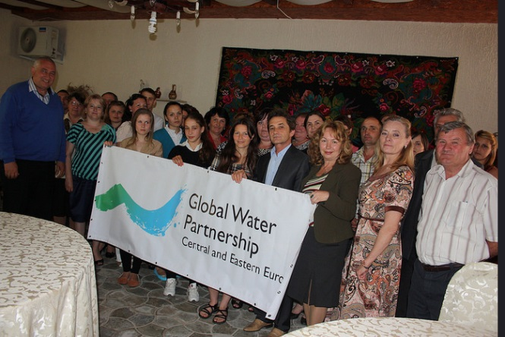
Agricultural drought monitoring and forecasting in Ukraine and Moldova
Working with rural authorities, farmers, local stakeholders
Upgrading of forecasting models for identification of crop yield losses caused by droughts
Guide on best practices on soil conservation

Slide 17
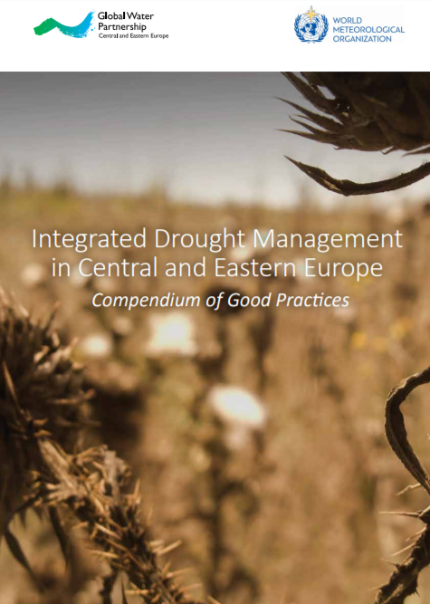
Main achievements 2013 - 2015
Overview of the situation regarding drought management in CEE
Guidance document for preparation of the Drought Management Plan
Communication links between the experts and policy makers
Increased capacity of the key actors to prepare Drought Management Plan
Achievements of the IDMP CEE 2013-2016
Collection of existing drought monitoring approaches and the establishment of a link with European database and monitoring service (EDO, DMCSEE)
Connections and exchange of information and results, with organizations in the region (DMCSEE, ICPDR, EUSDR, etc.)
Demonstration of new, innovative approaches in drought management linked to: Natural Small Water Retention Measures, soil water holding capacity, drought in forests, remote sensing data, etc.
Notes:
Overview of the situation regarding drought management in CEE
Guidance document for preparation of the Drought Management Plan in connection with the EU Water Framework Directive and global directions
Communication links between the experts and policy makers active in drought management at the country level
Increased capacity of the key actors to implement the entire process of preparing a Drought Management Plan in their own countries
Collection of existing drought monitoring indices, methods, and approaches from the CEE region, and the establishment of a link and integration of data into the European database and monitoring service (European Drought Observatory)
Demonstration of new, innovative approaches in drought management linked to: ◦ how to increase soil water holding capacity; ◦ how droughts impact forests and types of measures to avoid such impacts; ◦ how Natural Small Water Retention Measures can be used for flood prevention, and also to help retain water in the land during wet periods to make water available for ecosystems, agriculture, and forests during drought periods in river basins; ◦ an example of a framework for an integrated drought risk management system that can be applied to different drought contexts; ◦ how remote sensing data can be used as a drought monitoring method; and ◦ upgraded drought monitoring and forecasting in Ukraine and Moldova. • Connections, and exchanges of information and results, with organizations in the region that deal with similar issues.

Slide 18

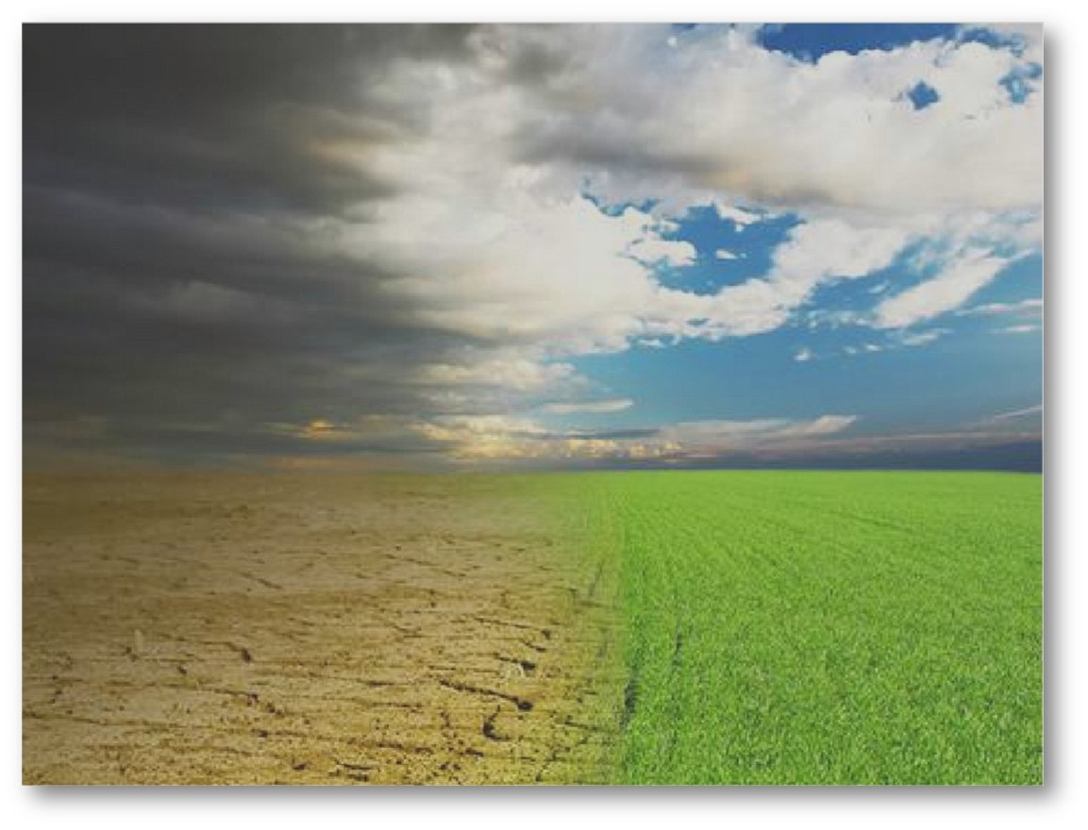
IDMP CEE 2017 – 2019 focus
Improve the drought monitoring and unification of drought impacts and risk assessments for the whole region
Built capacities to monitor, forecast, evaluate and respond during drought development with better accuracy and faster response time
Integrate water security and drought resilience into national development planning and decision-making processes

Slide 19
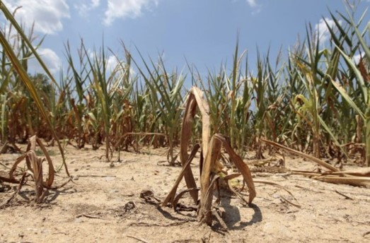
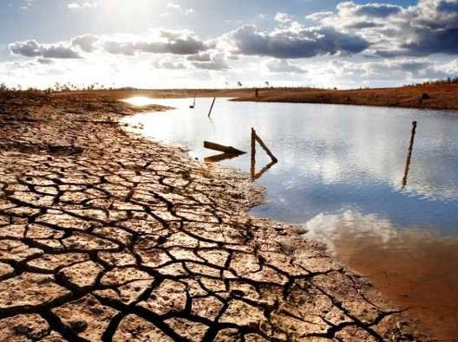
Thank you
for your attention
www.gwp.org/GWP-CEE/IDMPCEE
www.gwp.org/GWP-CEE
http://www.droughtmanagement.info/

