Slide 1
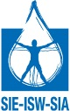
Improvement of governance and access to drinking water and sanitation in the rural sub-basin of Nirnova (Moldova)

Slide 2
Decentralized cooperation in the field of drinking water and sanitation
Convention between And
Artois Picardie Water Agency (AEAP)
Rhin Meuse Water Agency (AERM)
The National School of Water and Environment Engineering of Strasbourg (ENGEES)
Grand Est Solidarity and Cooperations for Development (GESCOD)
Alsace-Moselle Water and Sanitation Inter-municipal Structure (SDEA)
FRANCE
Solidarity Water Europe
SEE/SWE
Rayon of Nisporeni
Rayon of Hincesti
Water Agency : Apele Moldovei
Agency of Central Regional Development
French Embassy
MOLDOVA

Slide 3
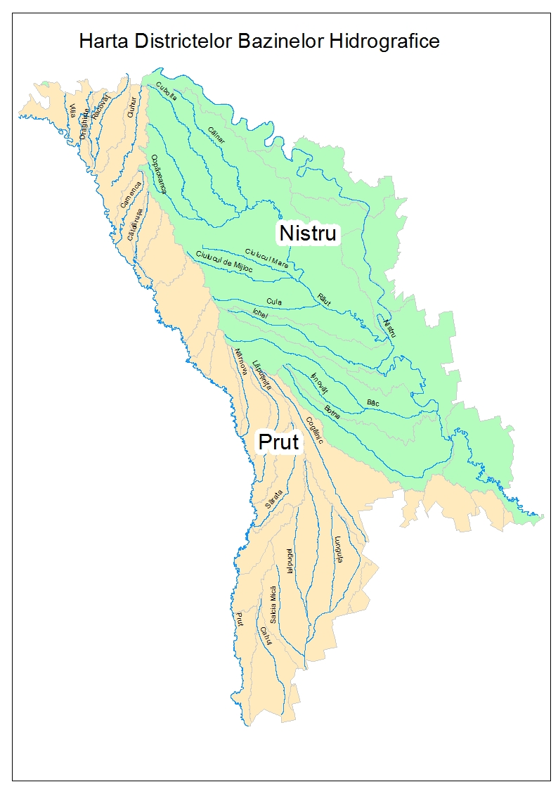
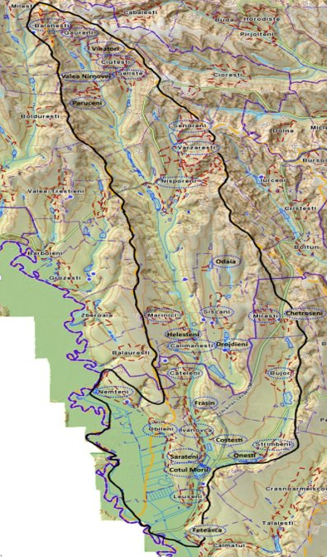
Project identification and localization : 30 municipalities concerned
2 Rayons
16 villages in Nisporeni
14 villages in Hincesti
Moldova two hydrographic basins
Nirnova sub-basin

Slide 4
Actual context of the project
43 858 inhabitants
30 % connected to WS system
15 % without Nisporeni
23 %
urban areas
Other part use wells and sources
4 municipalities have a sewer system
1 treatment plant in Nisporeni
15 % have a septic tank
77 %
rural areas

Slide 5
Building up a local inter-municipal structure covering the Nirnova sub-basin
Gathering the means and skills to reach the critical size and think at a proper scale
Become a credible project owner to design, implement and ensure the decentralized management of drinking water and sanitation projects
Establish a feasible multi-year programme for the development of municipal water and sanitation services, taking into account the considerable needs and constraints
Be a focal point for the local implementation, on the sub-basin of the NIRNOVA, of concrete actions envisaged by the basin management plan of the river PRUT

Slide 6
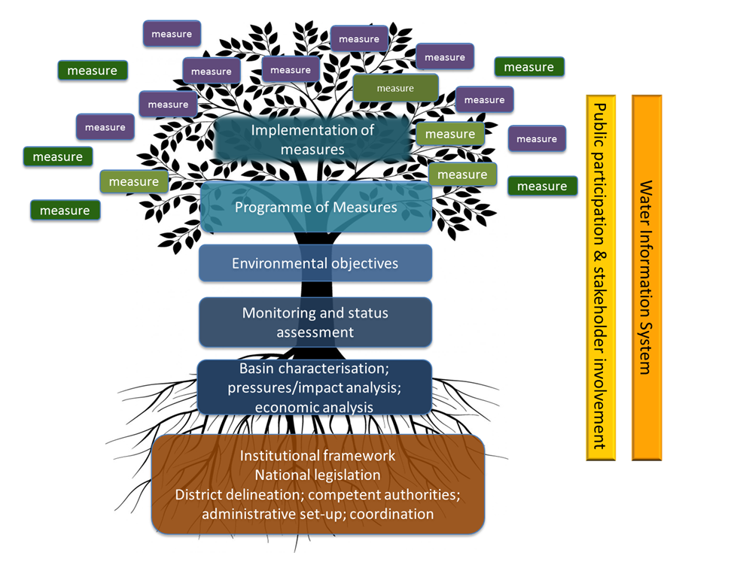
Link between inter-municipal structure and river basin Management Plan
Overall political vision of Management Plans
Local implementation of concrete measures and actions
The inter-municipal structure could be:
consulted and give its opinion for the elaboration of the Programme of measures (pressure on the resource, advice on the provisions to be retained in the PoM)
Support local implementation of selected measures

Slide 7
Project Implementation
A technical and institutional diagnosis of the sub-basin was carried out (Moldovan regulatory framework, water and sanitation situation in the villages, detection of first priority projects that can be financed)
Creation in Strasbourg in March 2018 of a Moldovan and Alsatian "platform of mayors", resulting in:
a consensus on the creation of an inter-municipal structure model of the Inter-municipal Development Association (IDA) type, with a technical operator
selection of a first series of demonstration projects (protection of catchment areas, construction of a wetland treatment plant, improvement of access to drinking water with pricing) for experience sharing at district scale with EUWI+ support

Slide 8
Project Implementation
Setting up of two task groups : - Inter-municipal structure development - Technical operator management
Presentation of the first solutions to the steering committee in early October
Proposal to contribute to better connect the measure implementation model developed at Nirnova sub-basin scale with the RBMPlanning process at Danube Prut and Black sea River Basin District scale including consistency of stakeholders involvement mechanisms
Legal form
Missions
Operating mode
Necessary skills
Choice
Organizing mode

Slide 9
An example of intermunicipal structure for improving water-sanitation governance in Moldova
More competent and credible project owner who could better carry out its mission on WSS development, financing project, attract and guide international aid
This model could constitute a standard strategic “meta-measure" that can be integrated to the programme of measure of the Moldavan 2 RBMP

Slide 10
Thank you for your attention

